Slide 1
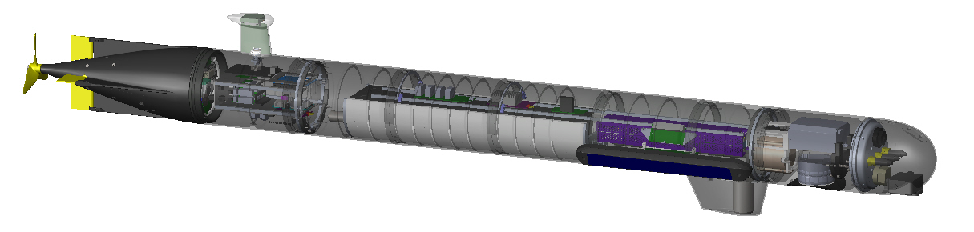
External Pressure Sensor
GPS/Iridiom Antenna
Wi-Fi & Radio Antennas
AHRS
Bulkhead Connectors for Additional Sensors
3D Sidescan Sonar
ACOMS
Transducer
IMU
DVL
GoPro Camera

Slide 2
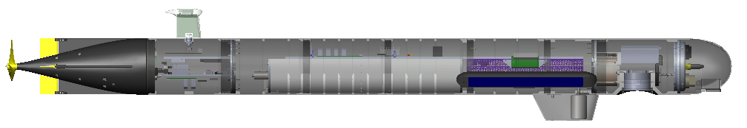
GPS/Iridiom Antenna
External Pressure Sensor
Bulkhead Connectors for Additional Sensors
AHRS
Wi-Fi & Radio Antennas
3D Sidescan Sonar
DVL
GoPro Camera
ACOMS
Transducer
IMU

